Slide 1
Drone Configuration
Fault Detection in Power Grid lines

Slide 2
Requirements
High Altitude Flying
Weight 2-25 kgs
Endurance 20mins minimum
Geo Fencing
NaviC and GPS both to be used in GNSS module
Distance 300m or more
Configuration: Quad copter or hexcopter or any other
Imaging payload
Laptop as GCS
GCS software with joystick control
360 degrees Collision Avoidance

Slide 3
Detection of Fault lines in Power Grid
Thermal Cameras
1080p camera
Gimble

Slide 4
Detection of Fault lines in Power Grid
Step 1: What Are You Detecting?
Thermal anomalies in powerlines typically include:
Hotspots on conductors
Overheated insulators
Connector/Joint overheating
Arcing/fault heating
So, your model should classify between normal vs. fault regions, and optionally segment the exact hotspot area.

Slide 5
Step 2: AI Algorithm
You have 2 main paths:
1. Classification / Anomaly Detection (Simpler)
CNN-based model: ResNet, MobileNet, EfficientNet.
Input: thermal image → Output: “normal” or “fault”.
Good if you just want a binary decision.
2. Object Detection / Segmentation (Better)
YOLOv8, YOLOv5, Faster R-CNN → detect & box hotspot areas.
U-Net, Mask R-CNN, DeepLabV3 → pixel-level segmentation of thermal anomalies.
Best if you want location + severity of the fault.
For drone powerline inspection, YOLOv8 (object detection) or U-Net (segmentation) are commonly used.

Slide 6
Step 3: How to Train
Dataset Collection
  Capture thermal images of powerlines under different loads, times of day, and weather.
  Label images into:
    Normal
    Hotspot (fault)
  If doing detection/segmentation, draw bounding boxes or masks around hotspots.
Preprocessing
  Normalize thermal data (map temperature range to grayscale or color).
  Augment dataset (rotate, flip, brightness, simulate noise).
Model Training
  Framework: PyTorch / TensorFlow.
  Use YOLOv8 if you want bounding boxes (faster on Jetson).
  Use U-Net if you want segmentation (heavier but more precise).
  Loss function: Cross Entropy (classification) or IoU Loss (segmentation).
Optimization for Jetson
  Convert trained model → TensorRT FP16/INT8.
  Run real-time inference at 15–30 FPS on Jetson Orin.

Slide 7
Stereo Camera Configuration for Collision avoidance 360°
1. Stereo depth principle (parallax/disparity → depth)
Two cameras are separated by a baseline B.
A feature projects to different pixel locations (disparity d) between left/right images.
Depth is computed as:
Z=f⋅B/d ,where f = focal length (pixels), B = baseline (meters), d = disparity (pixels).
This is the parallax method (geometry-based) — it’s the standard and still the foundation.

Slide 8
2. Practical stereo algorithms you can use
A) Classical methods (fast, well-understood)
Block matching / Semi-Global Block Matching (SGBM)
  Implemented in OpenCV (cv2.StereoSGBM_create).
  Produces reliable depth if good texture and calibrated cameras.
  Jetson can run SGBM at ~10–20 FPS for VGA resolution.
ELAS (Efficient Large-scale Stereo Matching)
  Lightweight, robust to textureless regions.
  Good balance between quality and speed.
Stereo BM (basic block matching)
  Very fast but noisy; not good enough for thin wires.
Best classical choice for drone: SGBM (Semi-Global Matching).

Slide 9
B) Deep-learning methods (better for thin wires & low-texture)
PSMNet / GCNet / AnyNet / FADNet / GANet
  More accurate disparity maps, can capture thin structures.
  Heavier compute; but some lightweight variants (AnyNet, MobileStereoNet) can run on Jetson Xavier/Orin.
RAFT-Stereo (2021)
  State-of-the-art accuracy, but computationally expensive.
  Jetson Orin could run at low FPS; Nano can’t.
Nvidia Isaac ROS GEMs have optimized stereo depth modules (StereoDisparity node using SGM on GPU) — designed for Jetson drones.
If you want thin wire detection, consider deep stereo (MobileStereoNet / AnyNet) on Xavier/Orin.

Slide 10
C)Hybrid methods (classical + refinement)
Run SGBM for coarse depth →
Refine with deep network edge-guided upsampler →
Gives higher edge precision without heavy compute.

Slide 11
3. For thin wires specifically
Wires are hard because they’re thin, low contrast, sometimes sub-pixel disparity.
Classical SGBM often misses them.
Options:
  Use higher resolution cameras (at least 720p or 1080p).
  Increase baseline distance (but limited by drone size).
  Apply edge-preserving disparity refinement (e.g., bilateral filtering).
  Fuse stereo depth with CNN-based wire segmentation → only check disparity along predicted wire pixels.

Slide 12
4. Recommendation for your drone (Jetson + Cube+)
If using Jetson Nano → use OpenCV SGBM (optimized, lightweight).
If using Jetson Xavier/Orin → use Nvidia Isaac ROS Stereo Disparity (GPU-accelerated SGM) or Mobile Stereo Net if you need higher accuracy.
For powerline inspection → best pipeline:
  Train a CNN to segment wires in RGB.
  Extract disparity only on those pixels (stereo-SGBM).
  Fuse across frames with IMU to track wires in 3D.
This way, you combine stereo parallax (geometry) + AI segmentation for thin wires.

Slide 13
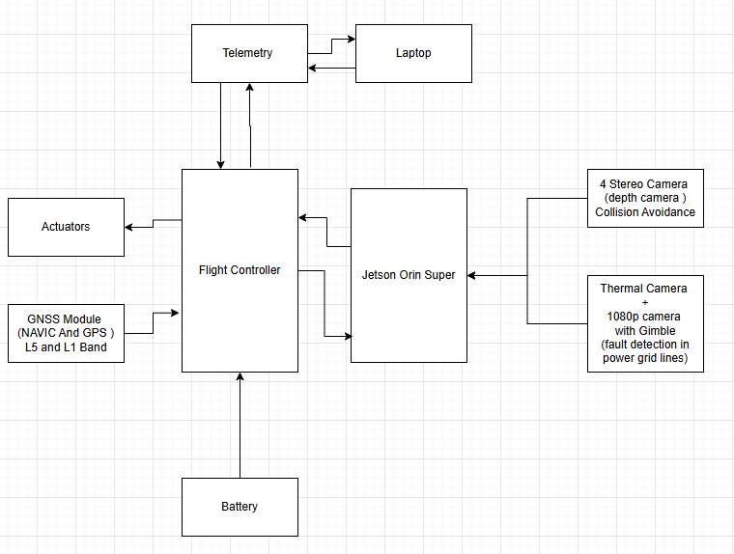
INTEGRATION BLOCK DIAGRAM

Slide 14
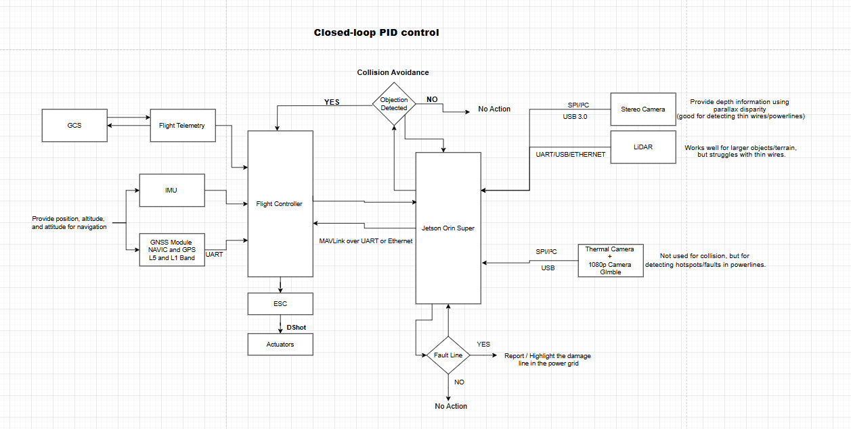

Slide 15
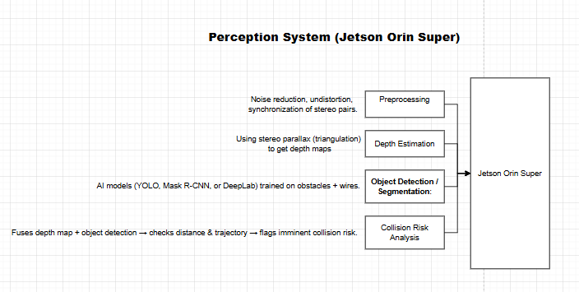

Slide 16
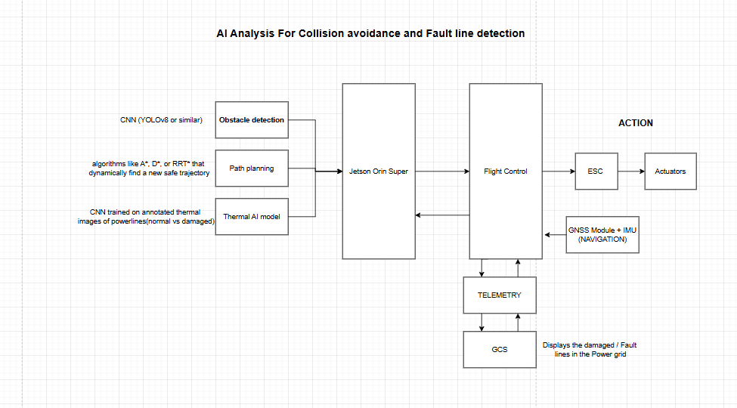

Slide 17
Power Consumption Theoretical Value
Power consumption estimate
Your payload list:
Jetson Orin Super → ~60–80 W
Stereo Cameras (Cube+ ×8) → ~3 W each → 24 W
Thermal camera → ~5 W
1080p camera → ~3–5 W
GNSS module → ~1–2 W
Flight controller + sensors → ~5 W
Motors/ESCs → this is the biggest draw → typically 200–300 W for a drone carrying this payload.
Total ≈ 300–400 W during flight.
Flight Time = 25-35 mins

Slide 18
AI Analysis for 360° Collision Avoidance
1.Stereo Cameras
Strengths
Depth Perception (Passive Sensing) – Can estimate depth using disparity maps without emitting signals (unlike LiDAR).
Rich Visual Data – Provides RGB texture, shape, color, and context (helps in classifying objects like vehicles, people, poles).
Lightweight & Low Power – Cheaper and less power-hungry than LiDAR.
High Resolution – Useful for object detection + AI-based classification.
Close-Range Accuracy – Works well at short distances (0.2m–20m depending on baseline).
Weaknesses
Lighting Dependency – Poor in low-light, shadows, or glare; fails at night unless aided by IR/thermal.
Computationally Expensive – Depth calculation from stereo images is heavy on Jetson GPU.
Accuracy Falls with Distance – Stereo disparity gets unreliable beyond ~20–30m.
Weather Sensitivity – Fog, rain, snow reduce accuracy drastically.

Slide 19
AI Analysis for 360° Collision Avoidance
2. 360° LiDAR
Strengths
Reliable Depth (Active Sensing) – Emits laser pulses, independent of ambient lighting.
Full 360° Coverage – Unlike stereo cameras (limited FOV), LiDAR provides all-around mapping.
Good for SLAM & Navigation – High accuracy for obstacle localization and mapping.
Works in Dark/Night – Since it projects its own light source.
Low Computational Cost – Point clouds are direct distance measurements.
Weaknesses
No Texture/Color – Only geometry, cannot classify objects alone (pole vs human).
Limited Vertical FOV – 2D LiDAR like X4Pro gives horizontal scan only (no 3D data).
Range Limits – X4Pro max ~10–12m (shorter compared to advanced LiDARs).
Sensitive to Weather – Rain, dust, sunlight interference can distort readings.
Mechanical Wear – Moving parts → less durable than solid-state sensors.

Slide 20
Methods
BEVFusion (Bird’s-Eye-View Fusion)
How it works: Fuses camera images + LiDAR into a bird’s-eye-view grid.
Strength:
  State-of-the-art in autonomous driving (Tesla-style).
  Handles object classification + localization in 3D.
  Very reliable in mixed environments. (up to 95–97% accuracy)
Weakness:
  More computationally heavy → but Orin Super can handle if optimized (TensorRT).

Slide 21
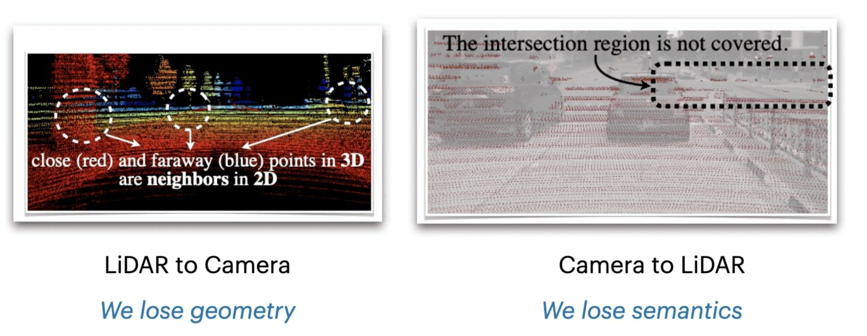

Slide 22
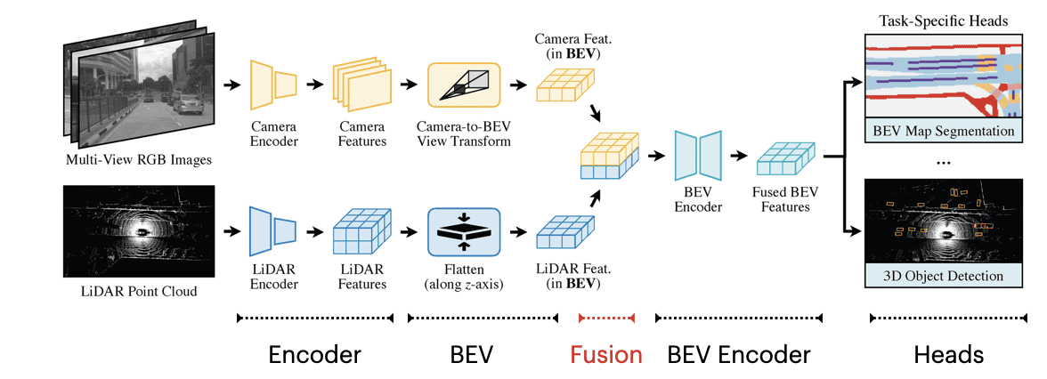

Slide 23
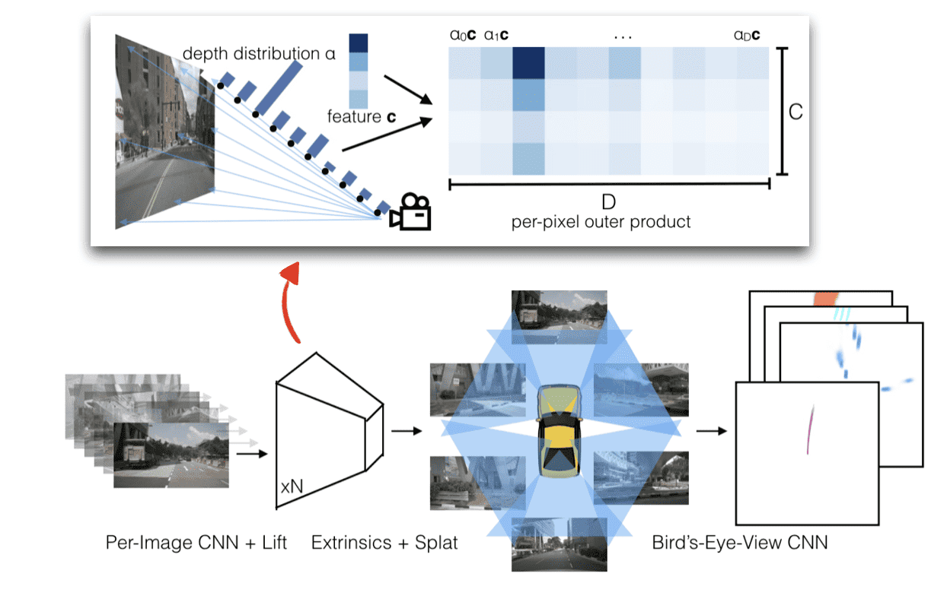

Slide 24
Multi-Modal Fusion Models (Best Overall)
Examples: MV3D, AVOD, MMF, BEVFusion
How it works: Takes LiDAR + camera inputs → extracts features separately → fuses → final detection.
Strength:
  Compensates weaknesses of each sensor.
  Most reliable (up to 95–97% accuracy) for collision avoidance.
Weakness:
  Training requires large datasets (KITTI, Waymo, or custom drone dataset).
  SIMILAR TO Bird’s Eye View

Slide 25
Methodology for Thermal Camera for fault detection in Power Grid
1) Goal & success criteria
Goal: Detect thermal anomalies (hotspots) on conductors, insulators, joints, clamps, transformers with a drone-mounted thermal camera and flag GPS locations for inspection.
Primary success metrics:
  Detection recall (true faults found) ≥ 92% (night/early morning).
  Precision (false alarms) ≥ 85% after post-processing / fusion.
  Localization error ≤ 1–3 m (GPS + camera geo-tagging).
  Operational latency: inference ≤ 200 ms/frame (real-time on Jetson Orin).

Slide 26
2)Hardware & sensor setup (practical)
Thermal camera: radiometric thermal camera with per-pixel temperature output preferred (e.g., FLIR/Teledyne or Skydroid C12 if radiometric). Radiometric simplifies ΔT measurement.
Resolution: higher thermal resolution → better small hotspot detection. Aim for ≥ 640×512 radiometric if possible; 320×240 still usable but needs lower flight height.
Lens / FOV: choose FOV such that GSD (Ground Sample Distance) at inspection altitude gives hotspot pixels ≥ 6–10 pixels across for reliable detection (see GSD formula below).
Stabilization: two-axis gimbal to keep camera nadir / desired angle and reduce motion blur.
GNSS/IMU: RTK GPS or precise GNSS preferred for sub-3 m geotagging; otherwise combine drone GPS + IMU + known camera extrinsics.
Lighting: thermal is independent of visible light — best flown at night or early morning to avoid solar heating false positives.
Data recorder: save radiometric images (temperature), timestamp, GPS, altitude, camera angle, and RAW metadata for each frame.
GSD (thermal) formula:
GSD (m/pixel) ≈ (Altitude * sensor_pixel_size) / focal_length
Practical rule: ensure a hotspot of interest (e.g., 1–2 cm heating at a clamp) produces ≥ 6 pixels across → choose altitude accordingly.

Slide 27
3) Flight planning & data collection protocol
Best time to fly: pre-dawn / early morning (minimal solar heating). Night if possible.
Altitude & speed: choose altitude so GSD gives hotspot ≥6 px; typical inspection altitudes 5–15 m for line inspections. Speed ≤ 3–5 m/s to reduce motion blur and ensure overlap.
Overlap & sweep: overlap ~60–80% forward, 40–60% side to ensure full coverage and multiple viewpoints for each asset.
Angle: nadir + oblique passes (15–30°) to see sides of insulators and joints.
Redundancy: capture each element from at least 2 different passes/angles.
Calibration runs: before main missions, fly a blackbody target and a known emissivity reference at same altitude to calibrate emissivity & temperature readings.

Slide 28
4) Preprocessing (radiometric & image corrections)
Emissivity correction: set camera emissivity to expected values (aluminum/steel vs ceramic insulator). If radiometric, store emissivity used.
Reflections & solar noise: filter frames captured during sunlit hours or apply reflection masks (specular highlights).
Denoising & down-sampling: apply temporal smoothing (median over 3 frames) to reduce noise. Keep original radiometric values for analytics.
Temperature calibration: use blackbody images to correct any offset/scale drift. If no blackbody, use known ambient references (transformer body).
Normalization: convert radiometric values to ΔT relative to local baseline (local mean ± std in local window) to detect local anomalies independent of absolute ambient.

Slide 29
5) Labeling & dataset preparation
Labels to collect: bounding boxes for hotspots, segmentation masks for heater regions, classes (conductor, insulator, clamp, transformer, corona, arcing). Also label false positives (sun glare, reflective metal).
Annotation tips: label exact hotspot region in thermal; keep tight boxes; also annotate component type in RGB if you have fused images.
Dataset variety: collect across seasons, day/night, weather, distances, altitudes. Include negative samples (healthy lines) and common confusers (sun reflecting, hot ground nearby, animals).
Sample size: aim for ≥ 5k thermal frames with ~3–10k hotspot annotations to start; for high-recall production push to 10–20k annotations.
Data split: train 70%, val 15%, test 15% — ensure split by flight/run to avoid leakage.

Slide 30
6) Model selection Pick a two-stage hybrid for best practical results:
Detector (real-time): YOLOv8 (or YOLOv7/tiny) on radiometric frames
  Purpose: fast hotspot candidate detection, class prediction.
  Why YOLOv8: good speed/accuracy tradeoff, easy TensorRT conversion.
  Output: bounding boxes + confidence + per-box max temperature.
Refinement (segmentation / anomaly scoring): UNet / DeepLabV3 on cropped hot candidates
  Purpose: precise hotspot mask, measure ΔT area and shape.
  Output: pixel mask, hotspot area, mean/max temp.
Anomaly / confirm stage (optional): Autoencoder or classical ΔT rule + temporal consistency
  Purpose: reduce false positives; use expected baseline (line temp pattern) and flag deviations.
Optional thermal+RGB fusion: If you also record RGB, run a lightweight classifier or use BEV fusion to confirm component context (is that hotspot on a clamp vs sun reflection?). Fusion increases precision.

Slide 31
7) Training strategy & augmentation
Input prep: feed radiometric values as single-channel float (not palette). If model expects 3 channels, replicate or add gradient/edge channels. Normalize per-image.
Augmentations: horizontal flip, small rotation, additive gaussian noise (to mimic sensor noise), brightness scaling (simulate ambient variance), random crops, blur to mimic motion. Do NOT arbitrarily change temperature scaling (preserve radiometry).
Losses: for detector use BCE + CIoU; for segmentation use BCE + Dice.
Hyperparams (starter): YOLOv8 small, lr=0.001, batch=16 (reduce if GPU memory), epochs=100, weight decay=0.0005. Use mixed precision (FP16).
Transfer learning: start from COCO/thermal pre-trained weights if available; fine-tune on your dataset.
Validation: monitor mAP@0.5, recall, precision, and per-class F1. Track temperature-based metrics: mean absolute error of predicted max temp within box.

Slide 32
8) Thresholding, scoring & decision logic
Thermal threshold (ΔT): set dynamic thresholds: ΔT_hot = max(5–10°C above local mean) for suspect, but tune per environment. Typical detection ΔT ≥ 7°C gives good precision; use lower ΔT for highly sensitive monitoring.
Confidence fusion: require both detector confidence ≥ 0.45 AND ΔT ≥ ΔT_hot OR segmentation IoU ≥ 0.4 to mark as confirmed.
Temporal confirmation: require hotspot detection in ≥2 consecutive frames (or from ≥2 viewpoints) within 2–3 s to reduce spurious flashes.
Geo-clustering: consolidate multiple detections within 3 m into one event; aggregate max temp, average, number of views.

Slide 33
9) Metrics & expected accuracy
Detection metrics: aim for mAP@0.5 ≥ 0.88, recall ≥ 0.92, precision ≥ 0.85 after fusion & temporal filtering.
Temperature accuracy: if radiometric calibrated, MAE ≤ 1.5–2.5°C typical; if non-radiometric, give relative ΔT only.
Localization: geotagging error depends on GPS; with RTK expect ≤0.5–1 m; with standard GPS expect 2–5 m. Camera pose/extrinsic errors add to this — calibrate carefully.

Slide 34
10) Deployment on Jetson Orin Super (real-time)
Inference engine: convert YOLOv8 → ONNX → TensorRT FP16, run with batch=1. For segmentation model do same.
Pipeline: capture radiometric frame → preprocess → YOLOv8 inference (GPU) → crop candidates → UNet inference (GPU) → scoring logic → log/telemetry.
Throughput targets: YOLOv8-nano/small + UNet (cropped) should reach 15–30 fps on Orin Super if optimized.
Memory & CPU: run sensor capture & GPS/telemetry on separate CPU threads, use zero-copy GStreamer for camera input to reduce latency.
Failover: if GPU overloaded, fallback to a lightweight rule-based ΔT thresholding to continue basic fault detection.

Slide 35
11) Post-processing & reporting
Event record: store: timestamp, GPS (lat,lon,alt), camera pose, bbox/mask, maxTemp, ΔT, confidence, images (thermal and RGB if available).
Operator UI: show overlay (hotspot box + temperature + map pin). Allow operator to confirm / reject. Keep audit trail.
Automation: auto-create ticket with location + image + predicted severity. Queue for follow-up inspection.

Slide 36
12) Testing, validation & field trials
Synthetic tests: create artificial hotspots using controlled heaters and known targets to validate sensitivity & calibration.
Field tests: run missions over known-good lines + planted faults. Measure recall/precision, MAE temperature, geotag error.
Edge cases to test: solar reflections, hot ground, rain/fog, heavy foliage, connectors behind insulators, multiple simultaneous faults.
Acceptance criteria: real missions show recall ≥ 92% and false positive rate ≤ 15% after operator filtering.

Slide 37
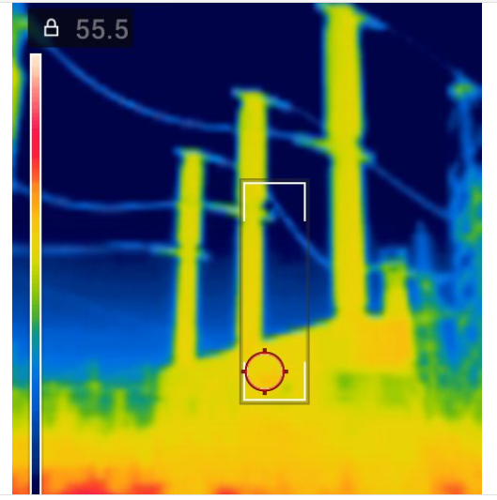
SAMPLES of Thermal Images Hotspots

Slide 38
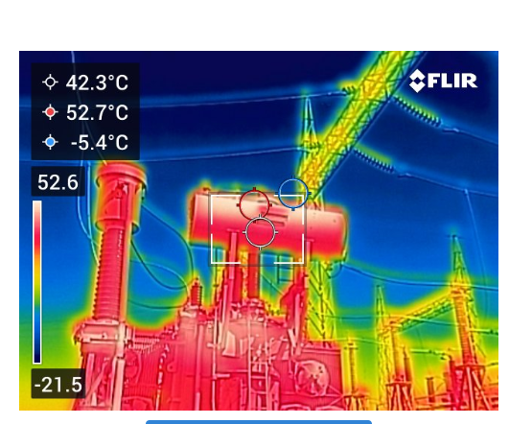
INDICATION OF HIGH Temperature and points the HOTSPOTS in power grid

